Slide 1

CN4005 Lesson 3 : IT Technology innovations and brainstorming ideas
Dr Fadi Safieddine
1

Slide 2
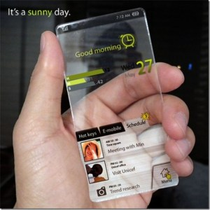


Lecture outline
Context of the lecture
The Assignment!
Topics of the assignment:
Sustainability, ethics, and inequalities.
Brainstorming Ideas

Slide 3

Context of the lecture
Your assignment has started!!
Task 3, 4, and 5 are covered in lesson 2 and this lesson.
Please start thinking about your topic.
You will be organised into groups during the lab session.
If you miss your lab session, you HAVE to email your lab tutor immediately to let them know!
This Photo by Unknown Author is licensed under CC BY

Slide 4

What is Sustainability?
The key points about environmental sustainability:
Recycle
Reduce
Reuse
Repair
Why should we care?*
Notes:
Class discussion….
We all live in one world
The melting of the polar ice will have serious consequences to all of us. https://www.youtube.com/watch?v=VbiRNT_gWUQ
Better environment means less pollution…less pollution means less illnesses.
Using less papers/energy/glass/…etc is good because it means less deforestation, less destruction to our environment, less use of our resources.

Slide 5
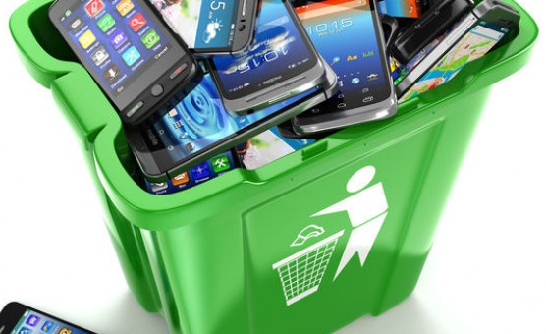
How does this relate to IT?
IT projects can help:
Saving fuel and pollution as people do not drive around searching for outlets.
Online product selling.
2. Paperless billing and e-tickets of all sorts save paper, ink, electricity, and definitely the trees.
Consider printing less where possible.
3. Reuse of products especially as they are resold on e-bay another website.
Don’t always go for new.
4. Less buildings for offices/stores, less electricity, less water and detergents, less building resources used
Justification for most e-commerce companies.

Slide 6

How does this relate to IT?
IT projects can help:
Encourage recycling and caring about the environment:
social media and apps.
Recycling electronics:
What to do with electronics once we no longer need them?
Why you should never throw them in landfills?
Use energy efficient settings:
Low bright
Auto-switch off
LED monitors / Lights
A+++ energy efficient products.

Slide 7

What is ethical in IT?
Ethical impact is about assessing and evaluation the impact of an activity on people and communities:
Employees, Customers, People, and Supply Chain.
It can also include ethical conduct and taking active measures not to be involved illegal activities:
Downloading or installing illegal software.
Using materials without authorization.
Facilitating anything involving computer crime.
Illegal spying on customers, people, and employees.
Distribution of spam.
Stealing using computers.
…etc.

Slide 8

How does this relate to IT?
Planning an idea:
It could be an idea that can help:
a. Reduce stress (mental health) from using computers.
b. Emphasizing breaks and exercises during long extended working hours.
c. Using ergonomic chairs and computer equipment.
d. Improve Health and safety.
e. Training managers and employees to consider impact of computers on themselves and others.

Slide 9

How does this relate to IT?
2- Innovative use of technology that would enhance our ethical impact:
Using ‘remote access working’ when employees are unable to come to work:
family illness, extended maternity leaves, extended recovery from operations…etc.
b. Using technology to make work accessible people with variety of abilities:
the blind, the deaf, wheelchair uses, and paralyzed individuals.
c. Donating old computers and IT equipment:
donating to less privileged schools rather than selling them at heavily discounted prices to middlemen who will get all the profit.
d. Encourage culture of buying equipment from established companies who encourage ethical practices in their supply chain.

Slide 10
End of Part 1
Activity 3.1. which of the following statements best describe the theme of the module assignment:
Develop an product that can support and help people and the environment.
Design a product that can support and help people and the environment.
Market a product that can support and help people and the environment.
Come up with an idea that can make you rich while also support and help people and the environment.

Slide 11

Brainstorming
Part 2
What is brainstorming?
When to use it?
Why to use it?
Process of brainstorming.

Slide 12

What is Brainstorming?
Brainstorming is a means of generating ideas.
Brainstorming can be used to identify alternatives, obtain a complete list of items and to solve problems.
There are a variety of brainstorming techniques.
The common principle of brainstorming is to set aside the restrictive thinking processes so that many ideas can be generated.

Slide 13
When to use brainstorming?
Developing the solution particularly in identifying alternative solutions.
Identifying all potential risks on a project.
Dealing with difficult problems that arise during the course of the project.

Slide 14
Why use brainstorming techniques?
Brainstorming can:
break through traditional thinking about a problem.
generate new ways of thinking.
provide an environment for building on new ideas.
reduce the tendency to prematurely discard new ideas.
facilitate team building.
encourage team problem solving.

Slide 15

The process of brainstorming
The environment
Setting the scene
Rules for the session
Running the brainstorming session
Affinity analysis
Summary and further action

Slide 16
The environment
Location: preferable to be held away from normal place of work
Room: natural light, plenty of space
Materials: whiteboard and pens. Provide a pack of post-it notes and pen for each attendee

Slide 17

Setting the scene…
Explain the brainstorming technique.
Specify the rules.
Loosening up: use a free thinking exercise and/or a practice brainstorming session*. For example: how could safety of taxi drivers be improved?
* The facilitator provides exercises and determines when the participants are ready to proceed with the technique.

Slide 18

Rules for the Session
Any idea is valid
No judgement or criticism allowed
Mobile phones switched off
Participants cannot leave the room during the brainstorming session

Slide 19


Comments that reduce Brainstorming to Braindrizzling
That won’t work | It’s against our policy
That’s too radical | We haven’t done it that way before
It’s not our job | That’s too expensive
We don’t have enough time | That’s not practical
That’s too much hassle | We can’t solve this problem

Slide 20
End of Part 2
Activity 3.2. Which of these statements is true about Brainstorming:
If not planned well, it can be counter productive.
Can help identify solutions but cannot be used to identify problems.
When done in groups it can generate more ideas.
Restricting the discussion to the topic helps the process of brainstorming.

Slide 21
BRAINSTORMING EXERCISE
Part 3
Suggest idea to reuse old cars.

Slide 22
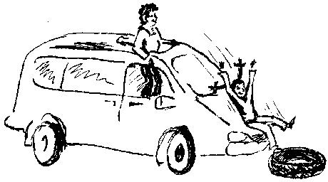
Suggested Uses of Old Cars as Equipment for a Children's Playground

Slide 23
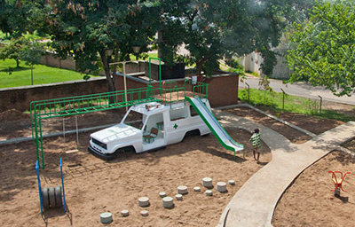
Example of this:

Slide 24
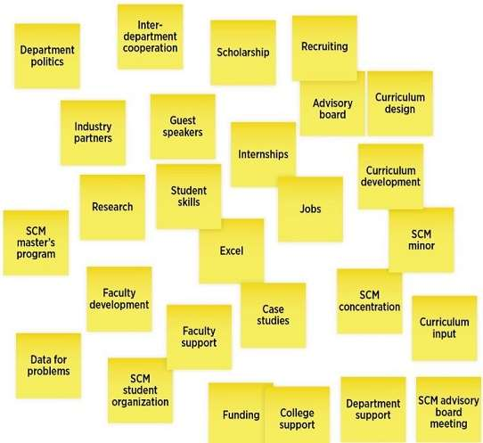
A brainstorming technique
Present the problem or opportunity for which brainstorming is being applied
Allocate 3-5 minutes to write on the post-it notes as many ideas as possible – one idea per note
Each person quickly writes their thoughts onto the post-it notes regardless of how impractical, outrageous, extreme, crazy they may be (do not filter the ideas)

Slide 25
Affinity analysis
Each person in turn sticks their post-it notes on the whiteboard, putting their note near to an idea that is similar to theirs. This should result in clusters of post-it notes representing similar ideas.
Review the ideas by cluster. For each type of idea ask the group “How could we make this work?” Discuss each variation of the idea and refine to develop a possible solution.

Slide 26
Summary and future action
Write up a summary of each type of idea/solution presented.
Determine an action plan for working through the ideas.
The action plan may be to test or further research the alternatives identified to select a shortlist of the most suitable solutions for further evaluation.

Slide 27
End of part 3
Activity 3.3: If the group cannot meet face to face to use the post-its, what alternative can they do from the list below:
Shared MS Word document on cloud?
Set up a MS Teams and use Whiteboard?
Or use any number of free online websites that allow creating virtual post-its?
Pick one and using your own words explain why you would use it!

Slide 28
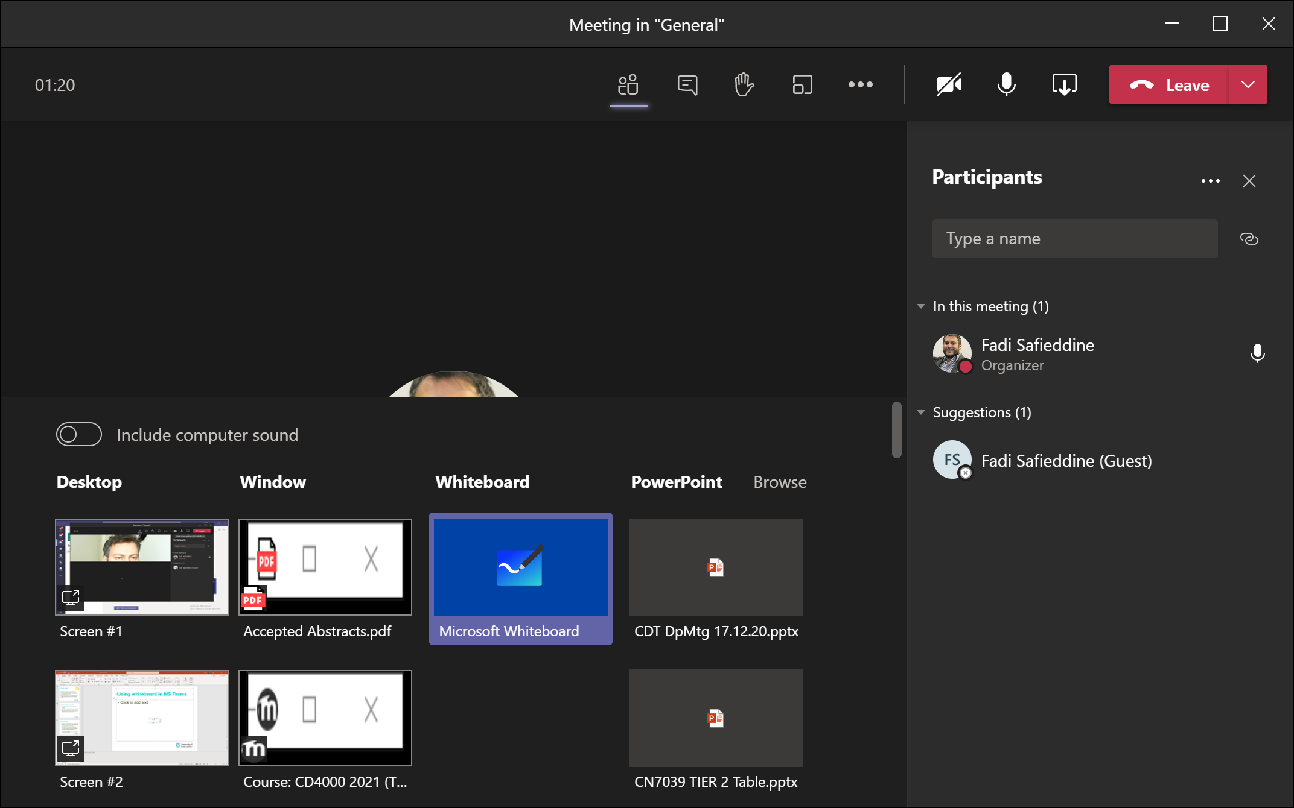
Using whiteboard in MS Teams

Slide 29
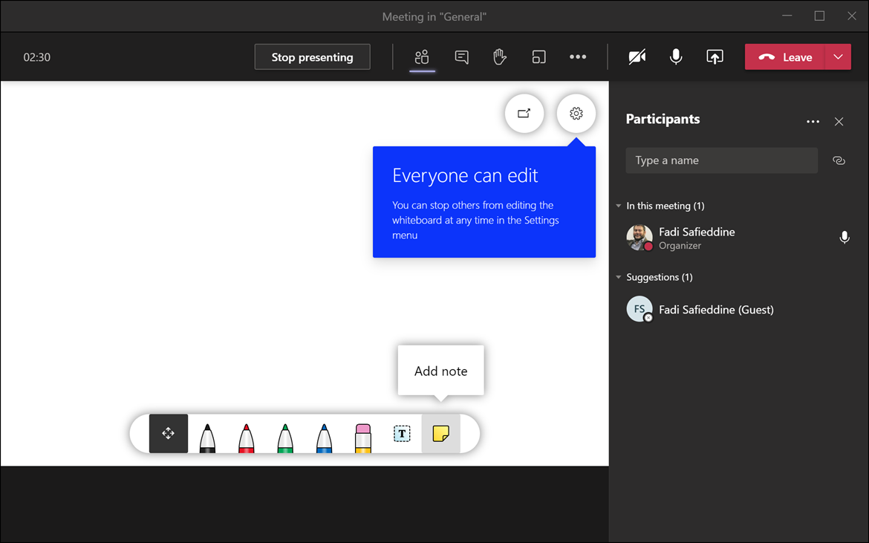
Using whiteboard in MS Teams

Slide 30
Part 4
Brainstorming Technique

Slide 31
Part 4
Brainstorming Technique
Number Two
Freewriting
What is it?
Think about the topic. Then write, write, write. Whatever comes into your brain – even if it doesn’t have to do with the topic. Example:

Slide 32


Brainstorming Technique
Number Two
Freewriting
Options:
Write for a specific time period
Write for a specific amount of paper

Slide 33
Brainstorming Technique
Number Two
Freewriting
??????
When is it helpful?
When you have NO ideas about a topic
When you have TOO MANY ideas about a topic
Maybe I could say this or maybe I could say that… hmmm

Slide 34
Brainstorming Technique
Number Three
Making a Cube
What is it?
Imagine a cube. It has six sides. On each side, you have a different task regarding the topic.

Slide 35
Brainstorming Technique
Number Three
Making a Cube
Side One: Describe the topic.
Describe
Compare
Associate
Analyze
Apply
Argue
Side Two: Compare the topic.
Side Three: Associate the topic.
Side Four: Analyze the topic.
Side Five: Apply the topic.
Side Six: Argue for or against the topic.

Slide 36
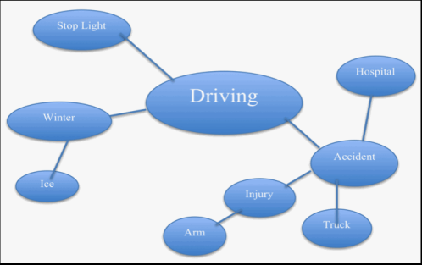
Brainstorming Technique
Number Four
Clustering
What is it?
When you write down words or concepts associated with the topic – any ideas that come into your mind

Slide 37
Brainstorming Technique
Number Five
Listing or Bulleting
What is it?
Create a list of terms/ideas/concepts about the topic. Create multiple lists depending on the purpose.
Global Warming
Toxic fumes
SUVs/Cars
Extinction
Belief/Disbelief
Paris Agreement
Belief/Disbelief
Scientists agree
Average American
China/USA
Normal occurrence or abnormal event?

Slide 38
Brainstorming Technique
Number Six
Paris, France
Paris, Texas
Venn Diagram
Capital
Became Paris in 400 A.D.
francophone
Cities
Eiffel Tower
County seat
Anglophone
Founded in 1839
What is it?
Draw two circles that connect, like this:
List two topics above the circles.
Brainstorm about the topics – what do they have in common and what is unique about each one.

Slide 39

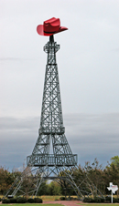
Brainstorming Technique
Number Six
Venn Diagram
When is it used?
When you are writing a comparison or contrast.
Paris, France
Paris, Texas
Capital
Became Paris in 400 A.D.
francophone
Cities
Eiffel Tower
County seat
anglophone
Founded in 1839

Slide 40
Brainstorming Technique
Number Seven
Tree Diagram
What is it?
This diagram has a central idea to which you add branches that focus on details.

Slide 41
Brainstorming Technique
Number Seven
Tree Diagram
When do you use it?
This type of diagram is helpful in brainstorming classification.
Media
Print
Visual
Audio
Newspaper magazine booklet
television webpage movie
digital analogue LP

Slide 42
Brainstorming Technique
Number Eight
T-Diagram
What is it?
Using a T shape, list a category that you want to compare or contrast about a specific topic or topics. Do this for a variety of categories.
Paris, France and Paris Texas
location
Europe
Northern France
North America
Northern Texas

Slide 43
Brainstorming Technique
Number Nine
Spoke Diagram
What is it?
Write the topic in a circle. Then think of about causes and effects. Write these around the circle like spokes on a wheel.
cars/suvs
too many people not recycling chopping down trees
Global Warming
Crazy weather
loss of polar ice caps
dying animals

Slide 44
Brainstorming Technique
Number Nine
Spoke Diagram
When is it useful?
Use this technique when you want to explore cause and effect.
cars/suvs
too many people not recycling chopping down trees
Global Warming
Crazy weather
loss of polar ice caps
dying animals

Slide 45
Brainstorming
For your assignment, you will need to show evidence of the brainstorming technique that you used to begin the innovation into IT pitching.
It’s part of your grade because it’s important!
Remember to ask for help or clarification if you need it.

Slide 46
Summary of the Brainstorming techniques:
Post-it
Freewriting
Making a cube
Clustering
Listing or Bulleting
Venn Diagram
Tree Diagram
T-Diagram
Spoke Diagram

Slide 47
End of part 4
Activity 3.4:
Select which one of these brainstorming ideas is your favourite:
Post-it
Freewriting
Making a cube
Clustering
Listing or Bulleting
Venn Diagram
Tree Diagram
T-Diagram
Spoke Diagram

Slide 48
Your first deadline already!!
Part 5

Slide 49
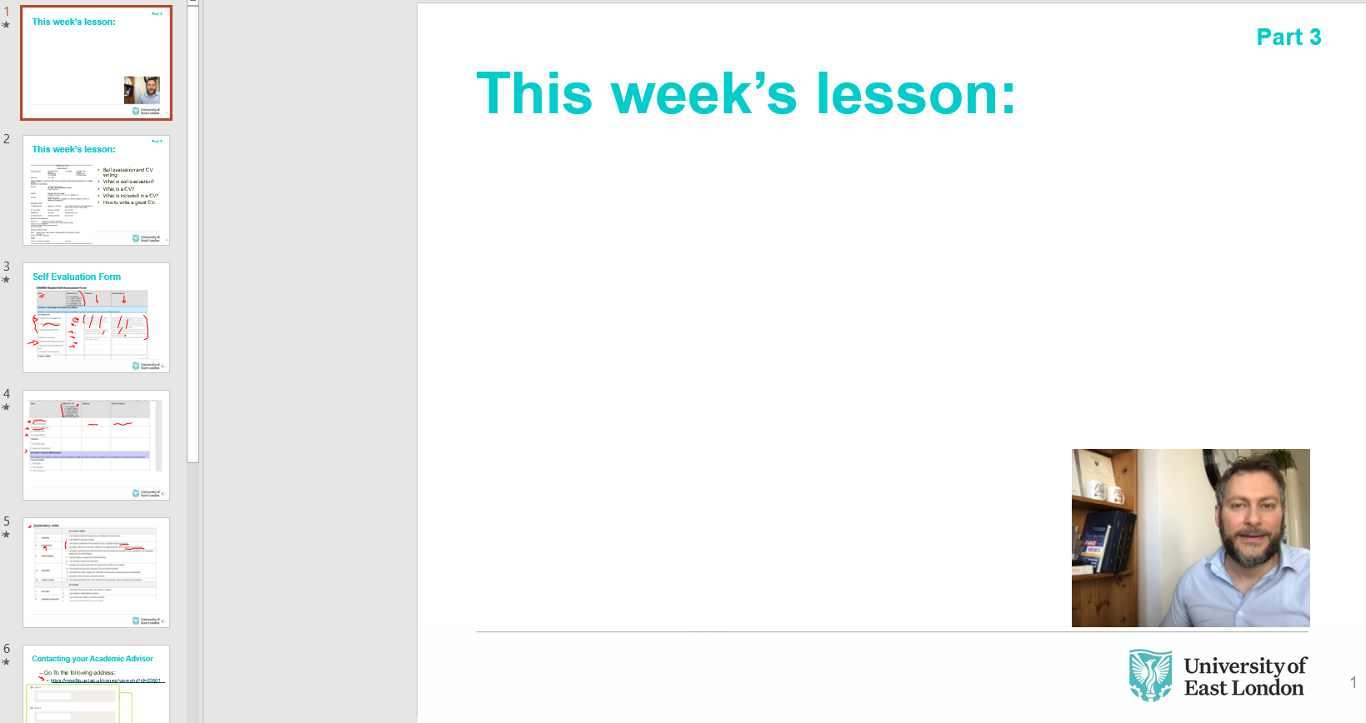
Your first deadline already!!

Slide 50
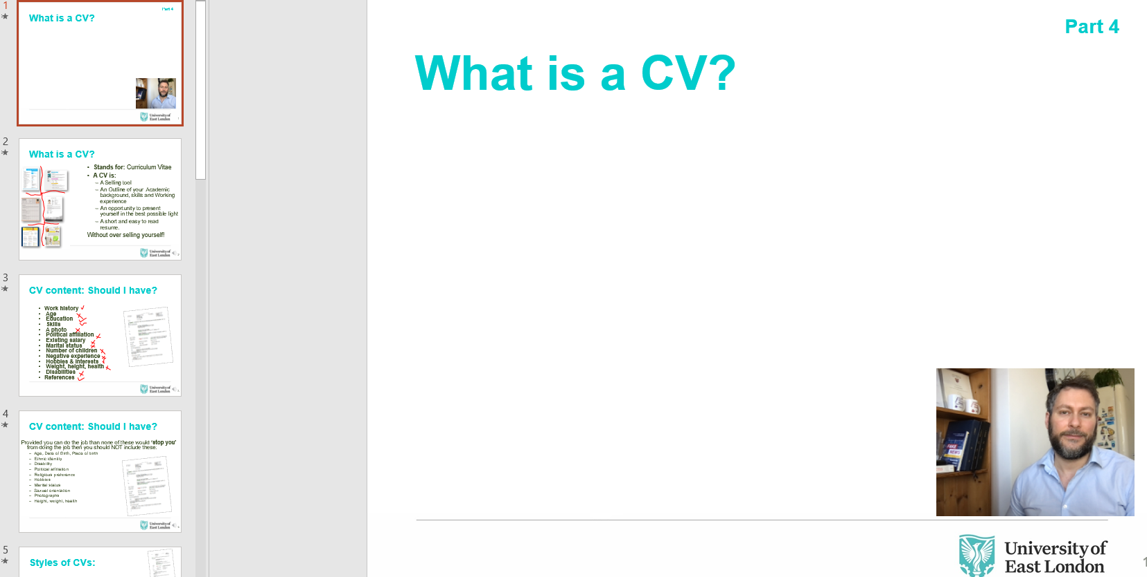
Your first deadline already!!

Slide 51
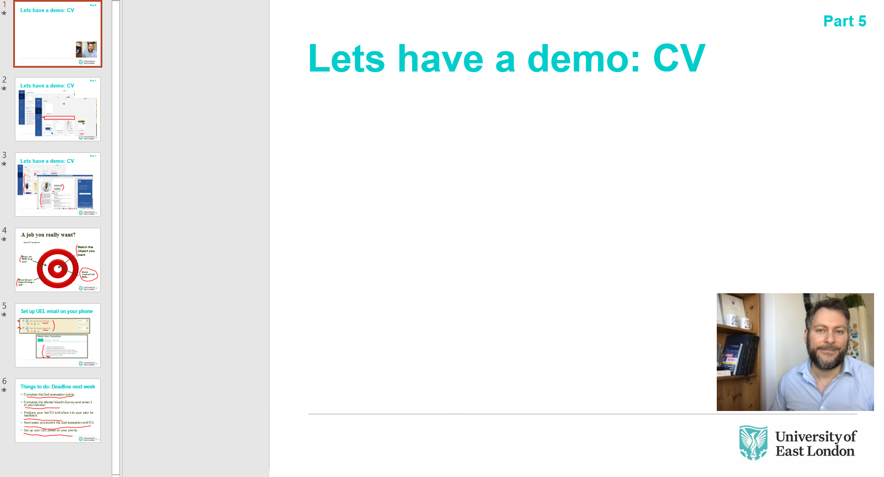
Your first deadline already!!

Slide 52
If you have any questions?
Remember to put these to your lab tutor!

Slide 53

CN4005 Lesson 3 : IT Technology innovations and brainstorming ideas
Dr Fadi Safieddine
Bloopers
53

Slide 54
Brainstorming
Part 2
What is brainstorming?
When to use it?
Why to use it?
Process of brainstorming.
Took the plant out, hoping she would stay away…she came looking for it!
Bloopers

